Slide 1
K-Nearest Neighbors Implementation as Binary Classifier
Dr. Kavita S. Oza

Slide 2
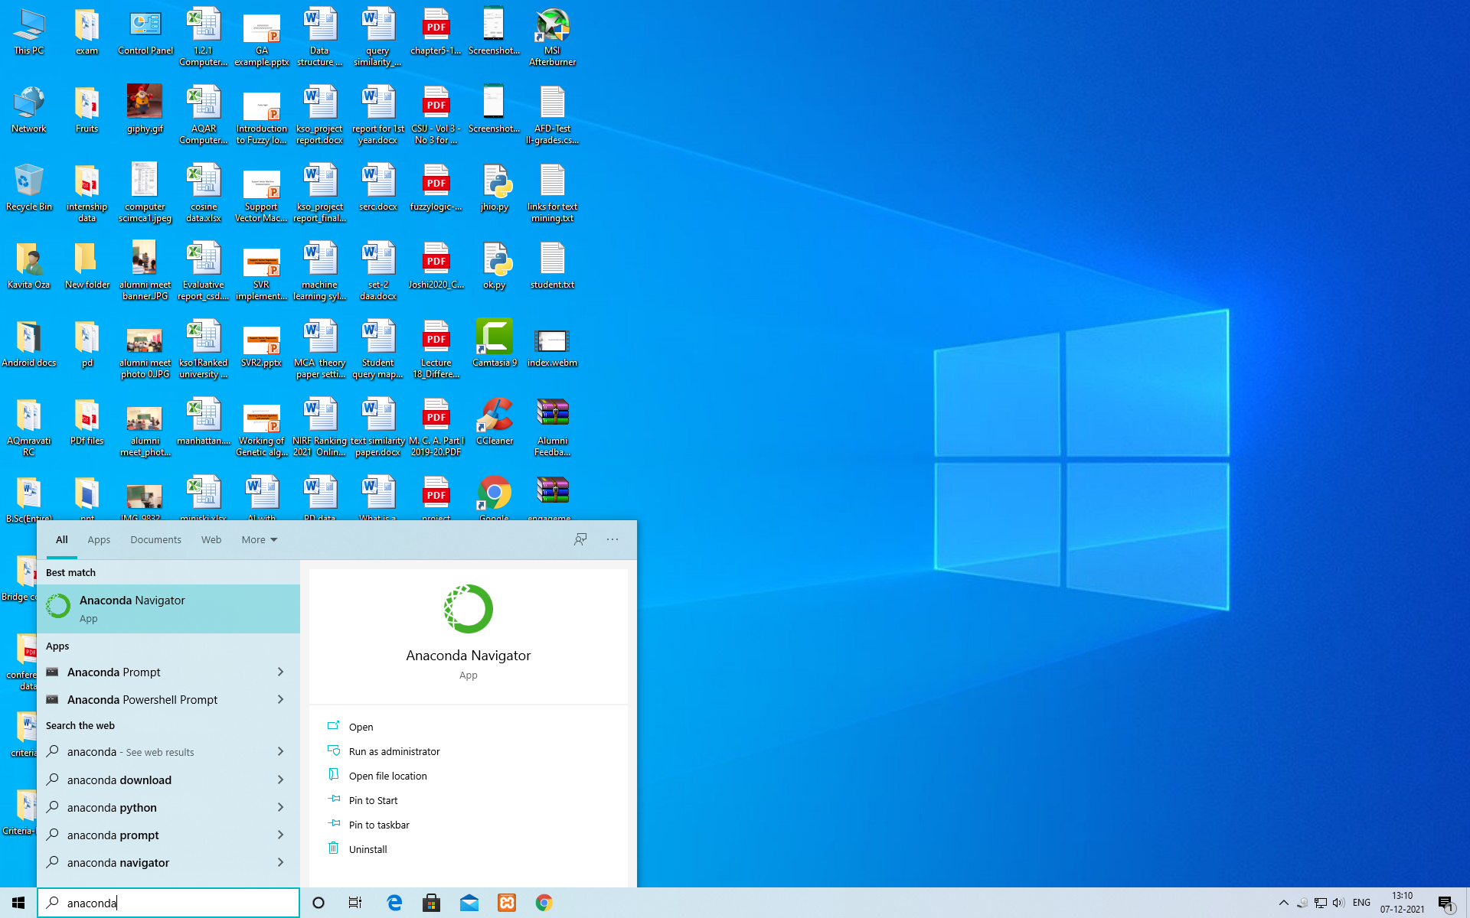
Anaconda Navigator

Slide 3
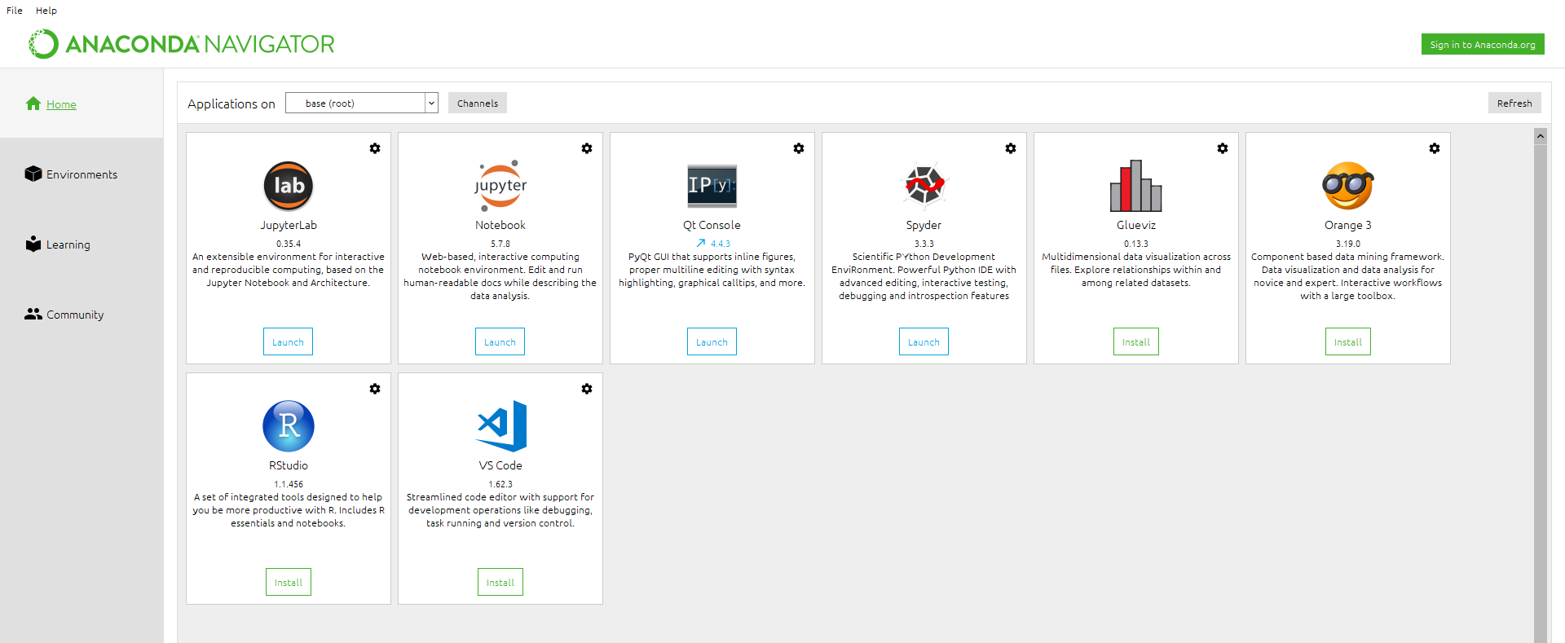
Open Anaconda navigator

Slide 4
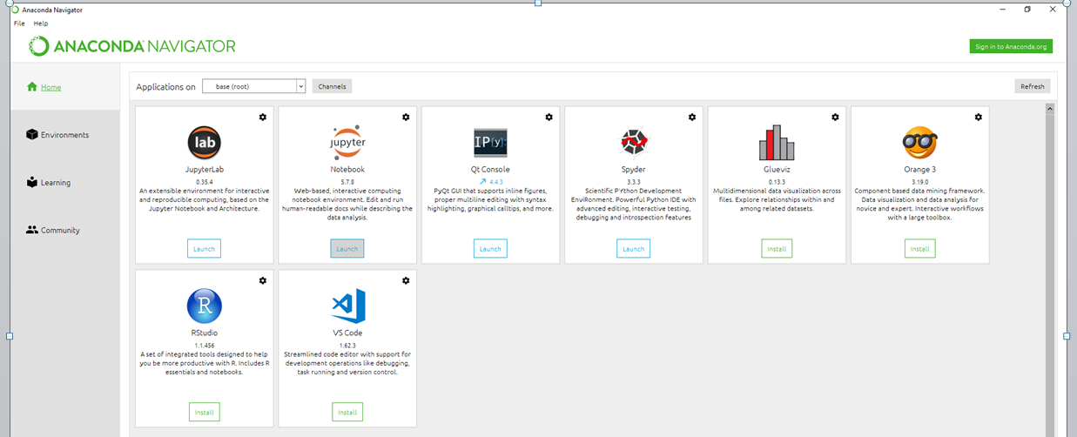
Click on Launch button of Jupyter Notebook

Slide 5
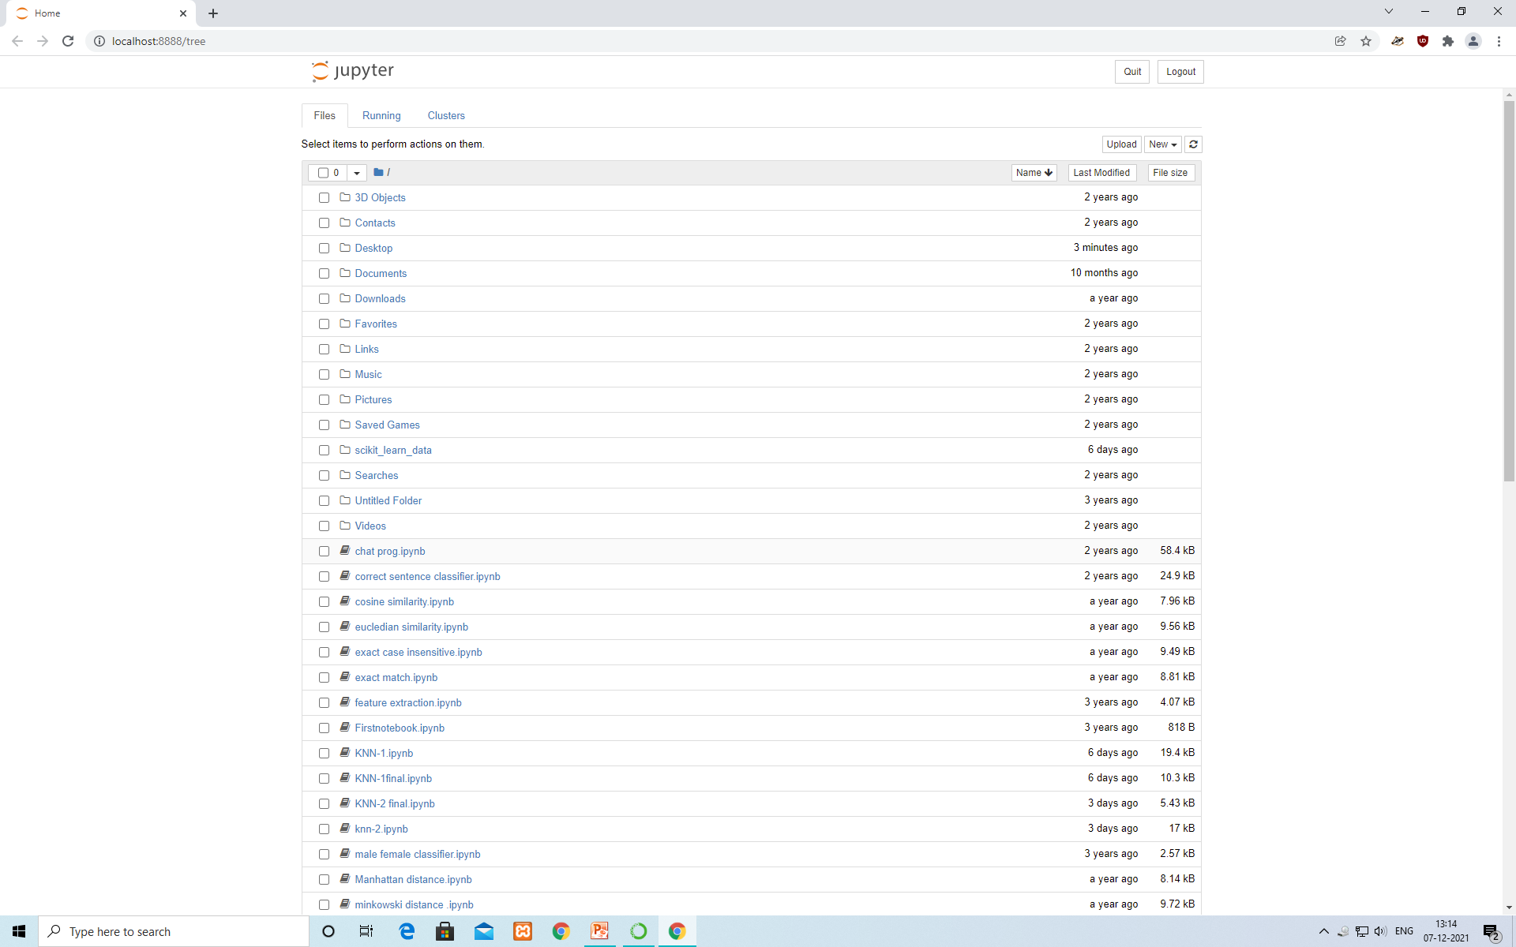
Jupyter Notebook

Slide 6
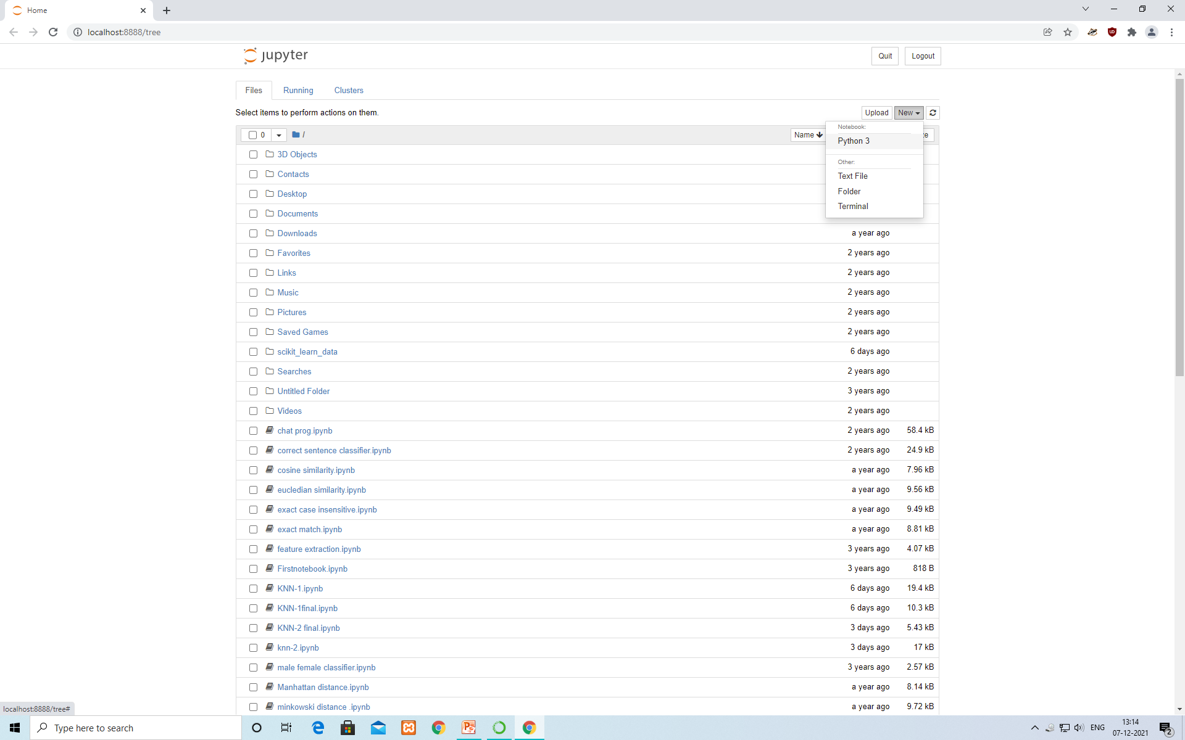
Click on New→ select Python3

Slide 7
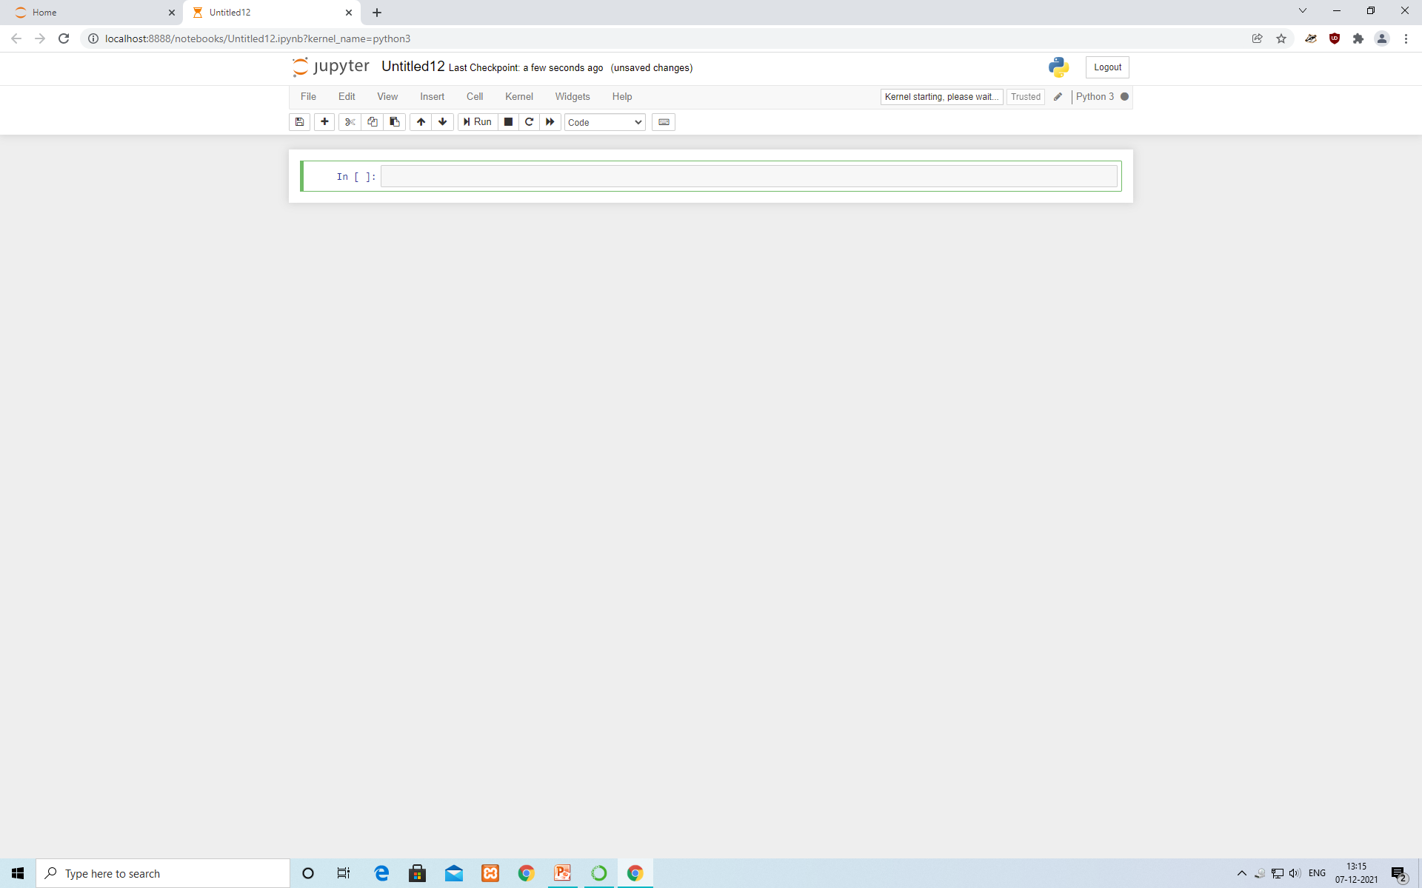
Jupyter Notebook interface

Slide 8
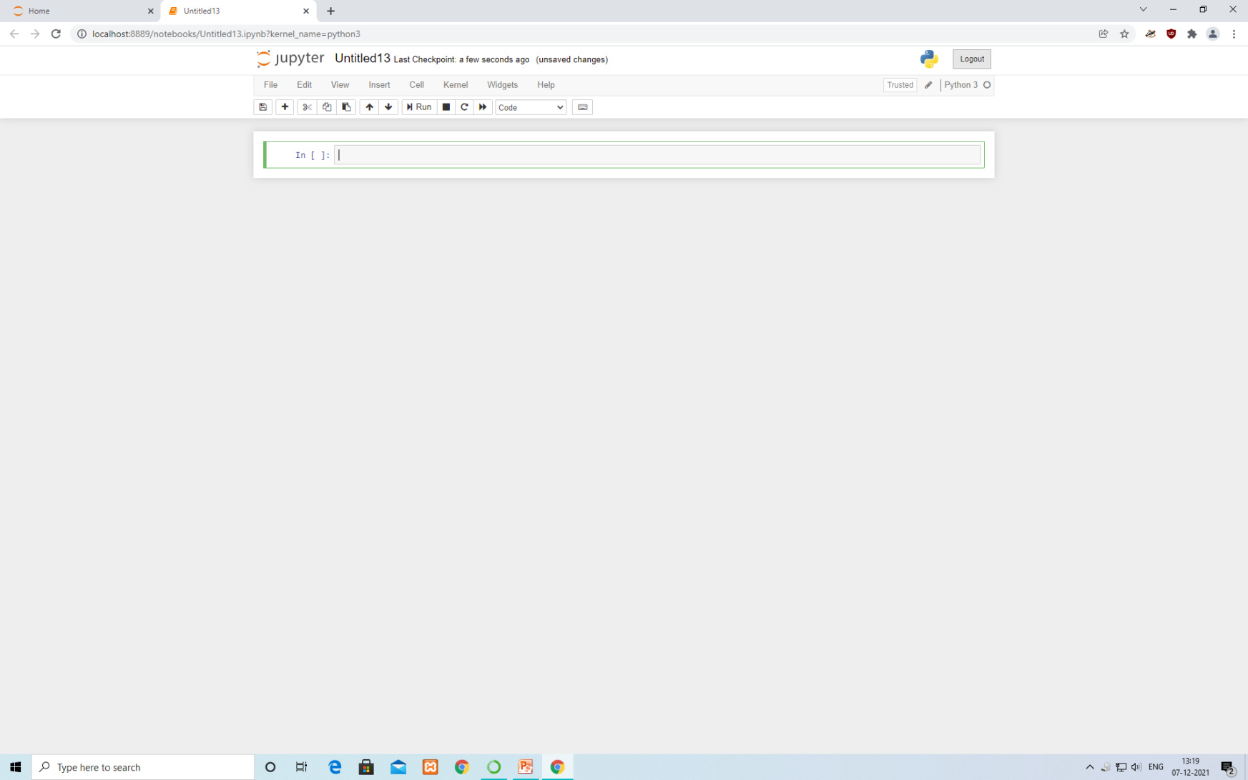
Logout from Jupyter Notebook

Slide 9
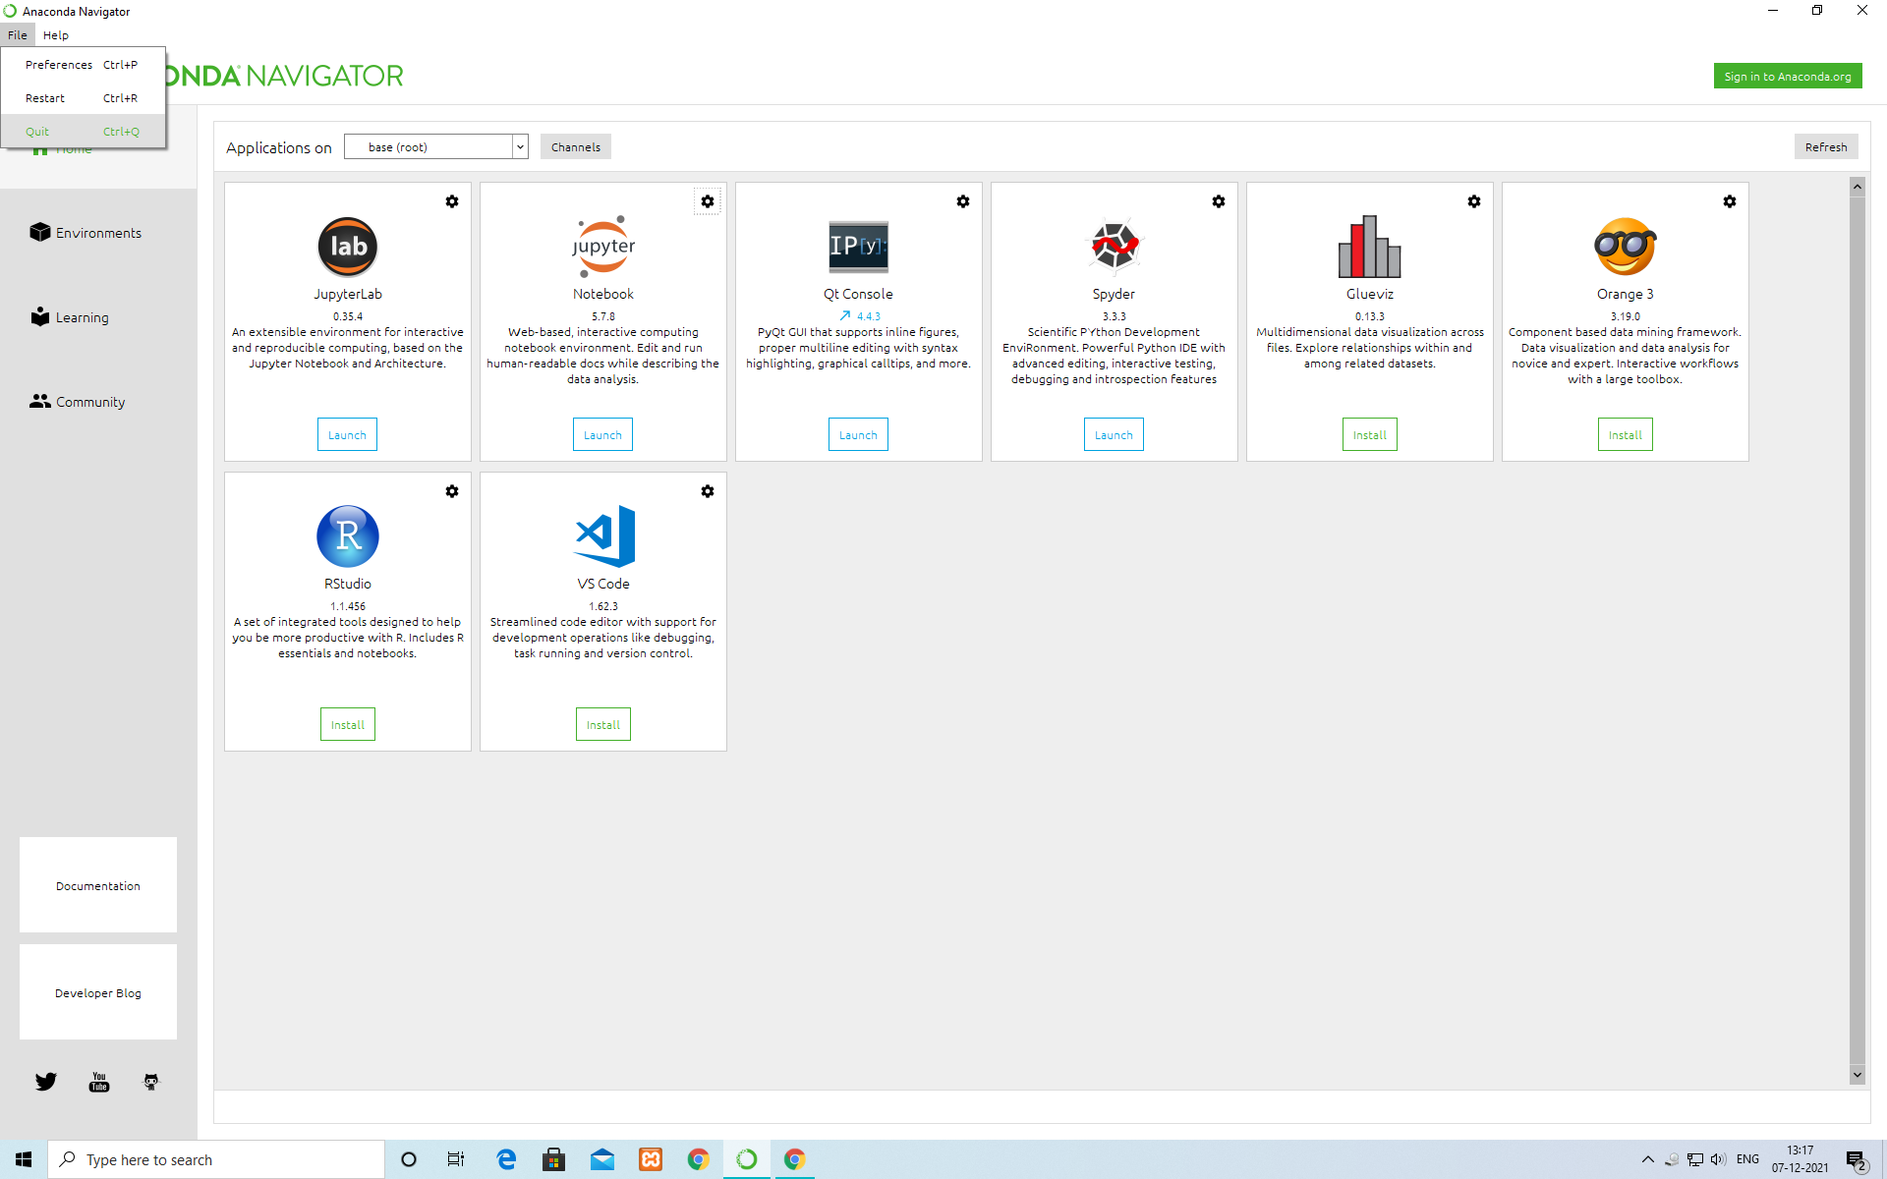
Quit Anconda Navigator

Slide 10
Data set
Feature
Label
Fever | Suffering from cold | Sore throat | Covid check (Label)
102 | y | y | y
103 | y | y | y
101 | y | n | n
99.9 | n | y | n
100 | n | y | y
100 | y | n | y
102 | y | n | y
100 | n | n | n
99.9 | y | y | n
102 | n | y | y
99.9 | n | y | n
101 | y | y | y
103 | y | n | y
103 | y | n | y
102 | n | n | n
Create your own dataset
Two kinds of attributes or columns in data:
Feature and Label

Slide 11
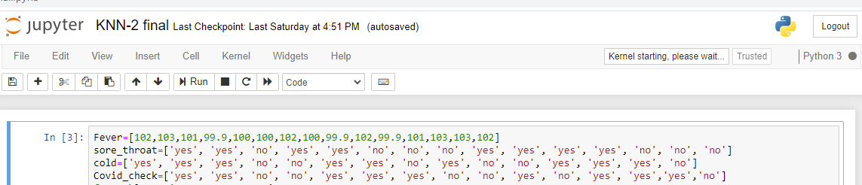
Defining Dataset
Assigning features and label variables
Three features (Fever, Sore throat and Cold) and one label (Covid Check).

Slide 12
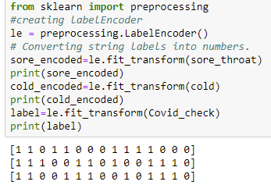
Encoding data columns: sklearn Label Encoder
converting string labels into numbers

Slide 13
Combining Features
Combine multiple columns or features into a single set of data using "zip" function

Slide 14
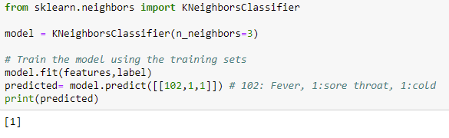
Generating Model: k=3
1.Import the KNeighborsClassifier module and create KNN classifier object by
passing argument number of neighbors in KNeighborsClassifier() function.
2.Fit model on the train set using fit() and
3. Perform prediction on the test set using predict().
In the above code, given input [102,1,1], where 102 means Fever, 1 means there is sore throat and 1 means having Cold. Model predicts [1], which means go for Covid Check.

Slide 15
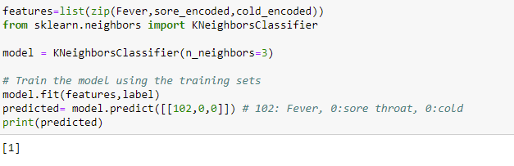
Model prediction: k=3
In the above code, given input [102,0,0], where 102 means Fever, 0 means there is no sore throat and 0 means no Cold. But Model still predicts [1], which means go for Covid Check.

Slide 16
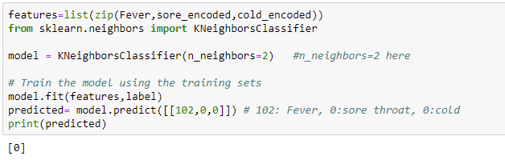
Model prediction: k=2
In the above code, given input [102,0,0], where 102 means Fever, 0 means there is no sore throat and 0 means no Cold. Model predicts [0], which means don’t go for Covid Check.

Slide 17
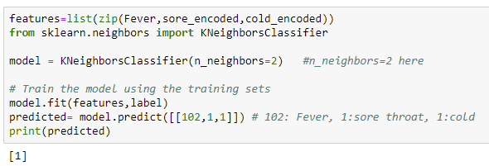
Model prediction: k=2…
In the above code, given input [102,1,1], where 102 means Fever, 1 means there is sore throat and 1 means having Cold. Model predicts [1], which means go for Covid Check.

Slide 18
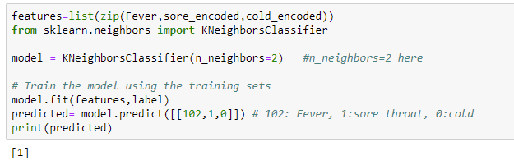
Model prediction: k=2…
In the above code, given input [102,1,0], where 102 means Fever, 1 means there is sore throat and 0 means no Cold. Model predicts [1], which means go for Covid Check.

Slide 19
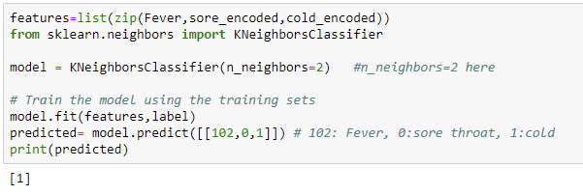
Model prediction: k=2…
In the above code, given input [102,0,1], where 102 means Fever, 0 means there is no sore throat and 1 means having Cold. Model predicts [1], which means go for Covid Check.

Slide 20
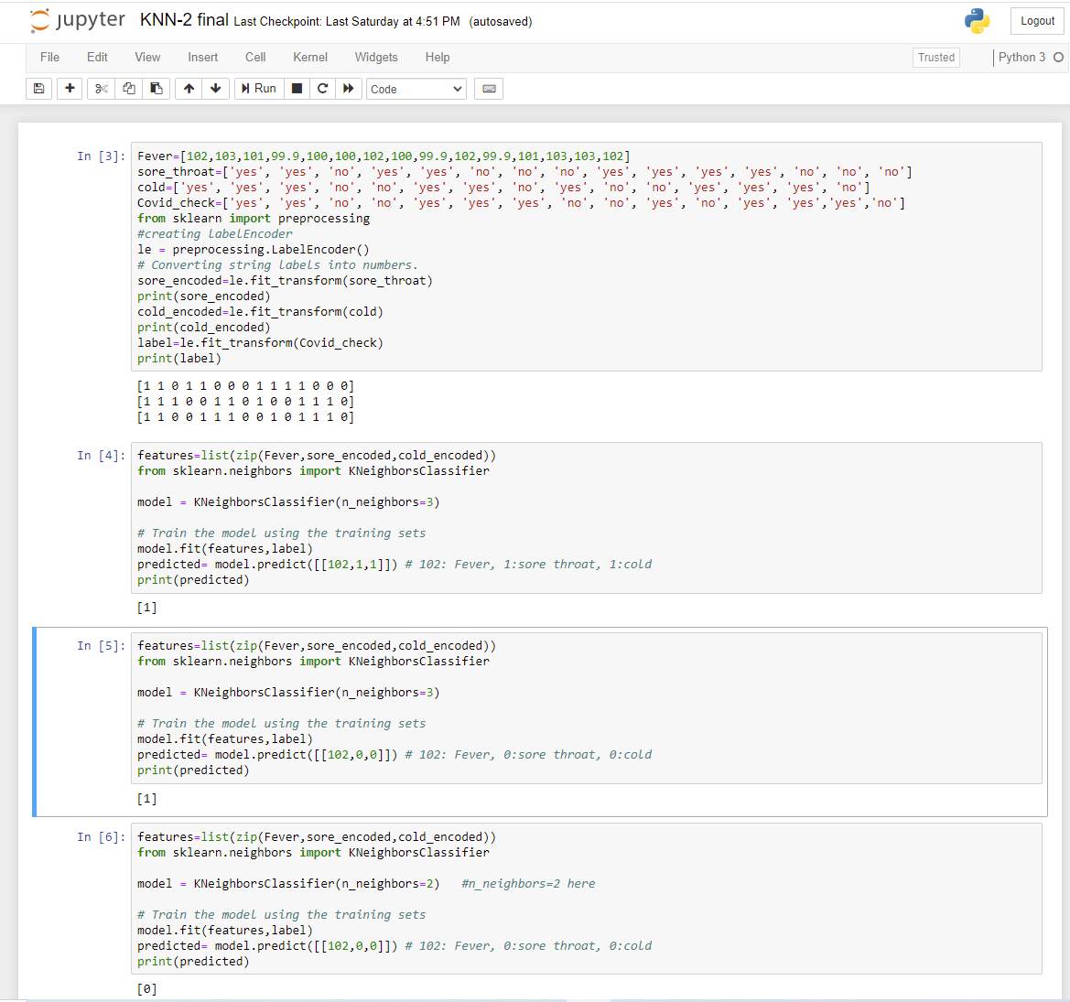
Program at a glance

Slide 21
Thank You

Slide 22
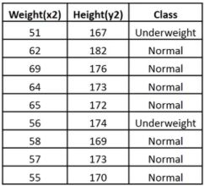
Example#2
Defining Dataset
Assigning features and label variables

Slide 23
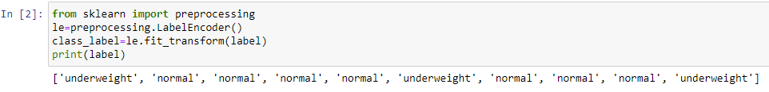

Encoding data columns: converting string labels into numbers

Slide 24
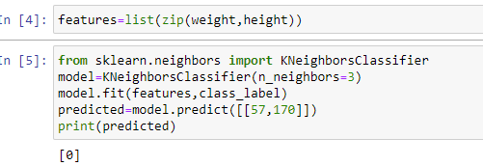

Combining Features, Generating Model & Model prediction
Normal

Slide 25

Model prediction…
Underweight
50 | 174

